Slide 1

Business Breakfast: Upgrade Your Security & Reduce Costs!
Thomas Rayner

Slide 2
Abstract
Session Description | Do you want the best productivity, collaboration, and modern business platform in the market for your small business? You might be surprised at how little it costs, and how easy it is to get started. Begin accelerating the professionalism, quality and impact your business has. Join Richard Harbridge, Chief Technology Officer of 2toLead, as he shares how other businesses are getting more out of Office and their email by leveraging Office 365 all while reducing the technology budget.
Technologies I intend to discuss:
- Office 365 Business Premium with apps
o Word
o Powerpoint
o Excel
o Publisher
o OneNote
- Outlook
- Sway
- OneDrive for Business
- SharePoint
- Skype for Business

Slide 3

Thomas Rayner
Follow me: @MrThomasRayner, workingsysadmin.com, linkedin.com/in/thomasrayner

Slide 4

Cutting costs is always important…
But we don’t want to scale down our technology capabilities.

Slide 5
6 Ways to save money and do more…
Consolidate IT License Investments
Get Rid Of Old Servers
Upgrade To Windows 10
Subscribe To Office (In The Cloud)
Improve IT Security
Simplify Device Management

Slide 6
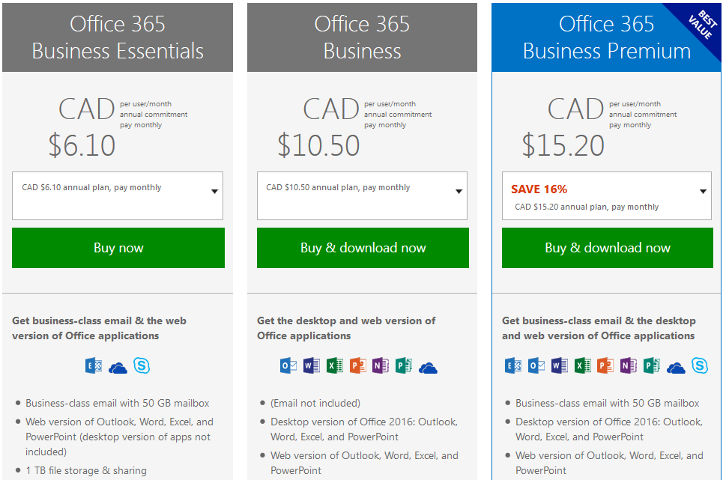
#1. Consolidate IT License Investments…
Do you have mail, video conferencing, document storage/sharing and more?
Reduce your license costs by getting everything together in Office 365 & Azure.
Notes:
Companies often maintain multiple IT licenses—for everything from video conferencing software and productivity solutions, to email and hosting. Managing all these service agreements and vendors is no small task. So why not consider an end-to-end integrated solution in the cloud, like Microsoft’s Office 365 and Azure? You’ll benefit from state-of-the-art productivity and you’ll save money.

Slide 7
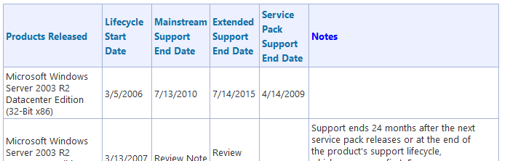
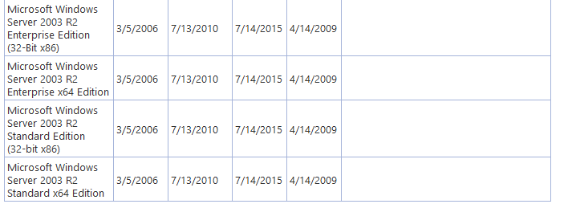
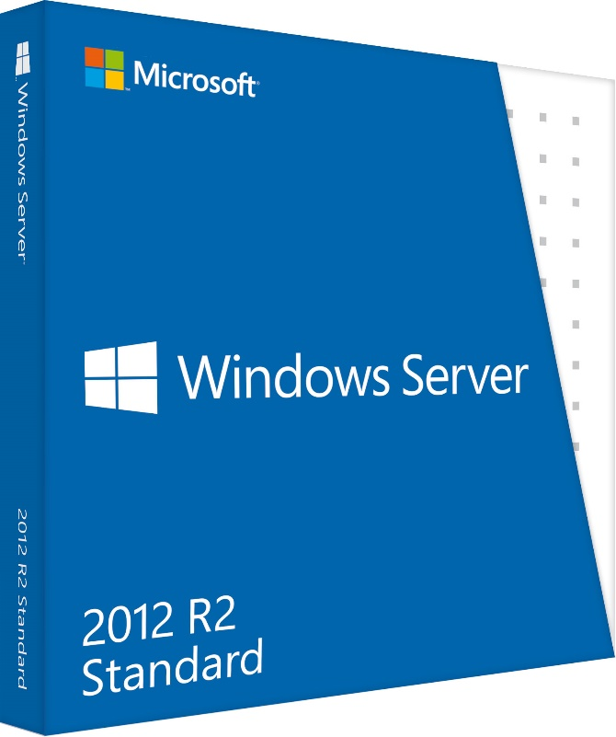
#2. Get Rid Of Old Servers…
Why is it important to modernize those servers?
No More Patches
No More Security Updates
Like The 37 Critical Updates In 2013 Alone
No Safe Haven
No Compliance
Adopt a cloud strategy. Transition away from having physical servers.
Get off of Windows Server 2003 and old server products.
Notes:
If you’ve got old servers running out-of-date software, you can make the leap to the cloud and cut costs. Windows Server 2012 R2 will provide you with state-of-the-art security and performance, without having to maintain machines—let alone buy new ones. You may even be able to reclaim your server room! This migration is a must for anyone still running Windows Server 2003, which is no longer supported by Microsoft.

Slide 8
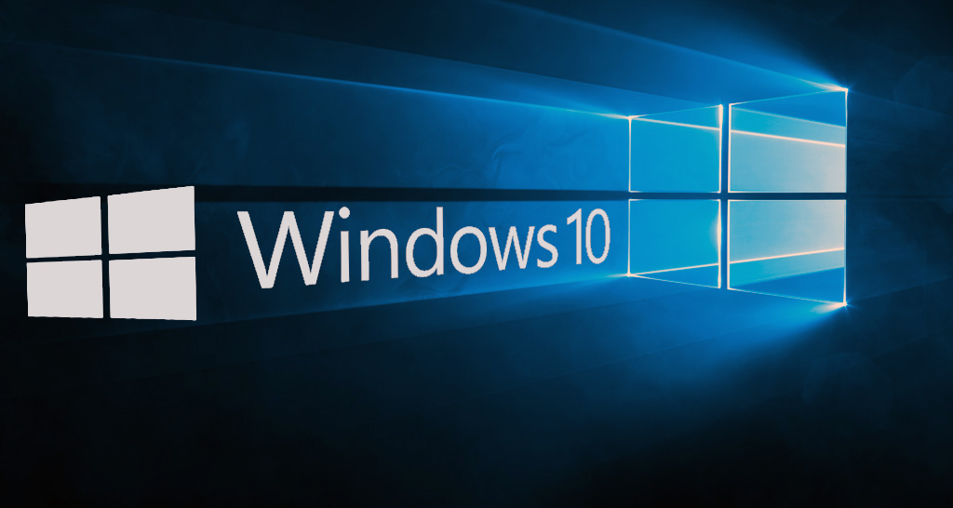
#3. Upgrade to windows 10…
Free windows upgrade for any device running Windows 7, 8, or 8.1.
Boost productivity without having to increase spending.
Notes:
Microsoft is offering a free upgrade of any device running Windows 7 or Windows 8.1 to Windows 10, a first from the company and an opportunity for you to boost your competitiveness. There are lots of ways your business will benefit from this upgrade, but one is how Windows 10 provides a single, scalable mobile device management solution to help you keep costs down.

Slide 9
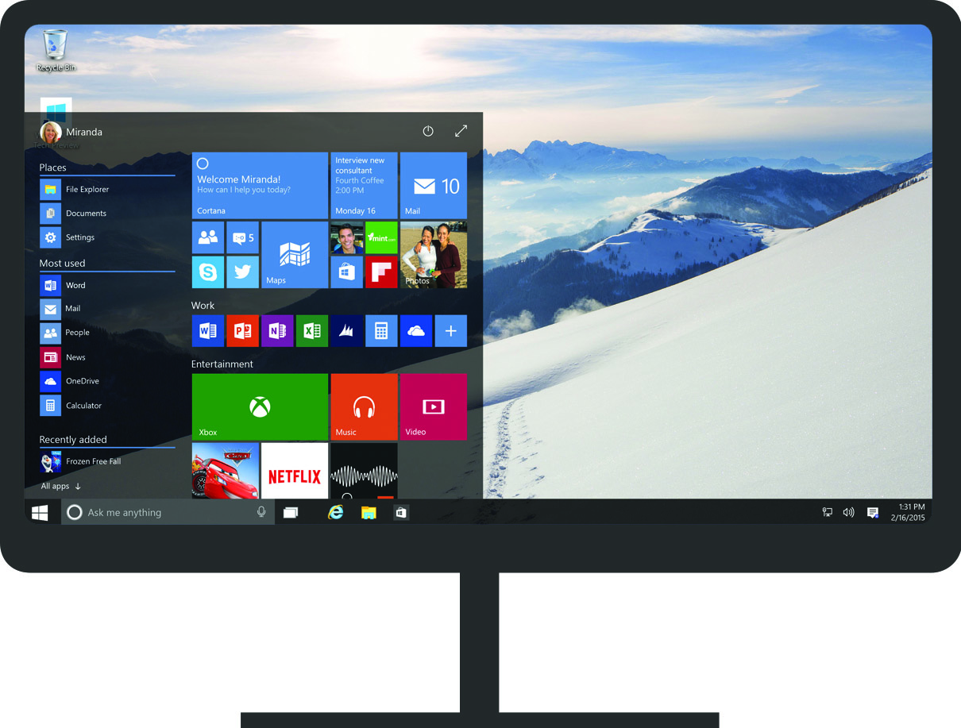
#3. Upgrade to windows 10…
Pin your favourite apps in the taskbar and use live tiles in improved start menu.
Notes:
Microsoft is offering a free upgrade of any device running Windows 7 or Windows 8.1 to Windows 10, a first from the company and an opportunity for you to boost your competitiveness. There are lots of ways your business will benefit from this upgrade, but one is how Windows 10 provides a single, scalable mobile device management solution to help you keep costs down.

Slide 10
#3. Upgrade to windows 10…
Snap apps to a corner and use your screen more effectively.
Notes:
Microsoft is offering a free upgrade of any device running Windows 7 or Windows 8.1 to Windows 10, a first from the company and an opportunity for you to boost your competitiveness. There are lots of ways your business will benefit from this upgrade, but one is how Windows 10 provides a single, scalable mobile device management solution to help you keep costs down.

Slide 11
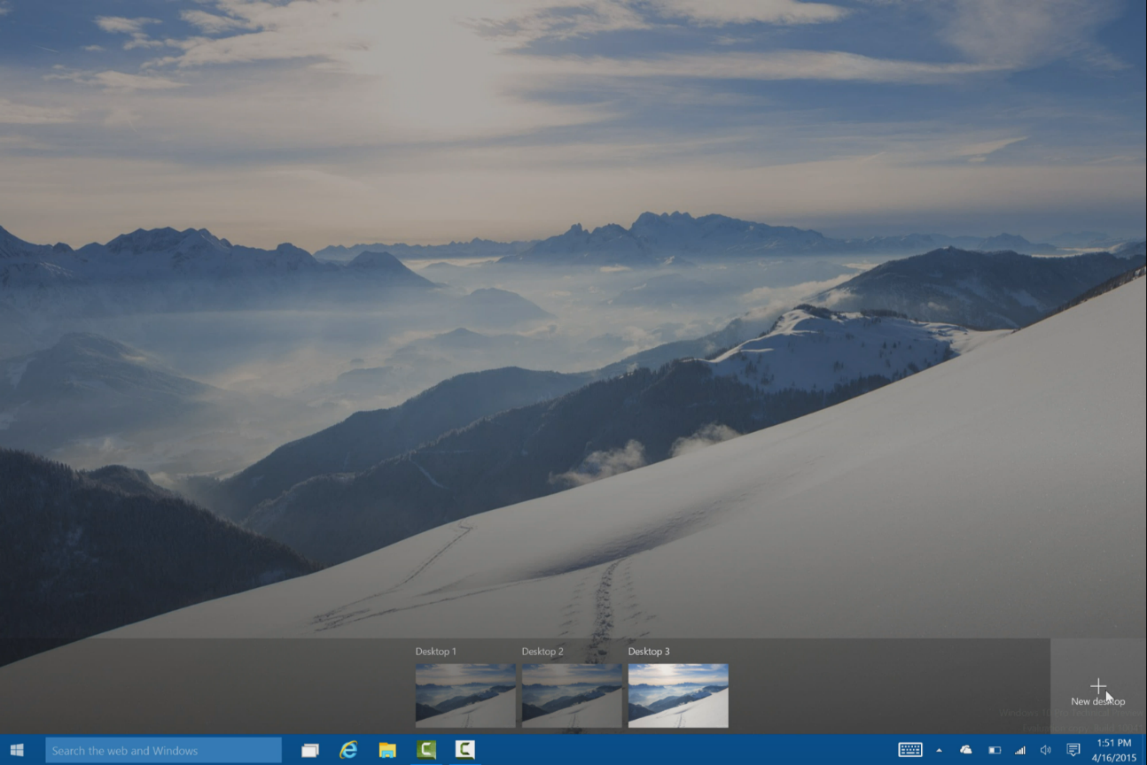
#3. Upgrade to windows 10…
Have multiple virtual desktops setup just the way you want them.
Notes:
Microsoft is offering a free upgrade of any device running Windows 7 or Windows 8.1 to Windows 10, a first from the company and an opportunity for you to boost your competitiveness. There are lots of ways your business will benefit from this upgrade, but one is how Windows 10 provides a single, scalable mobile device management solution to help you keep costs down.

Slide 12
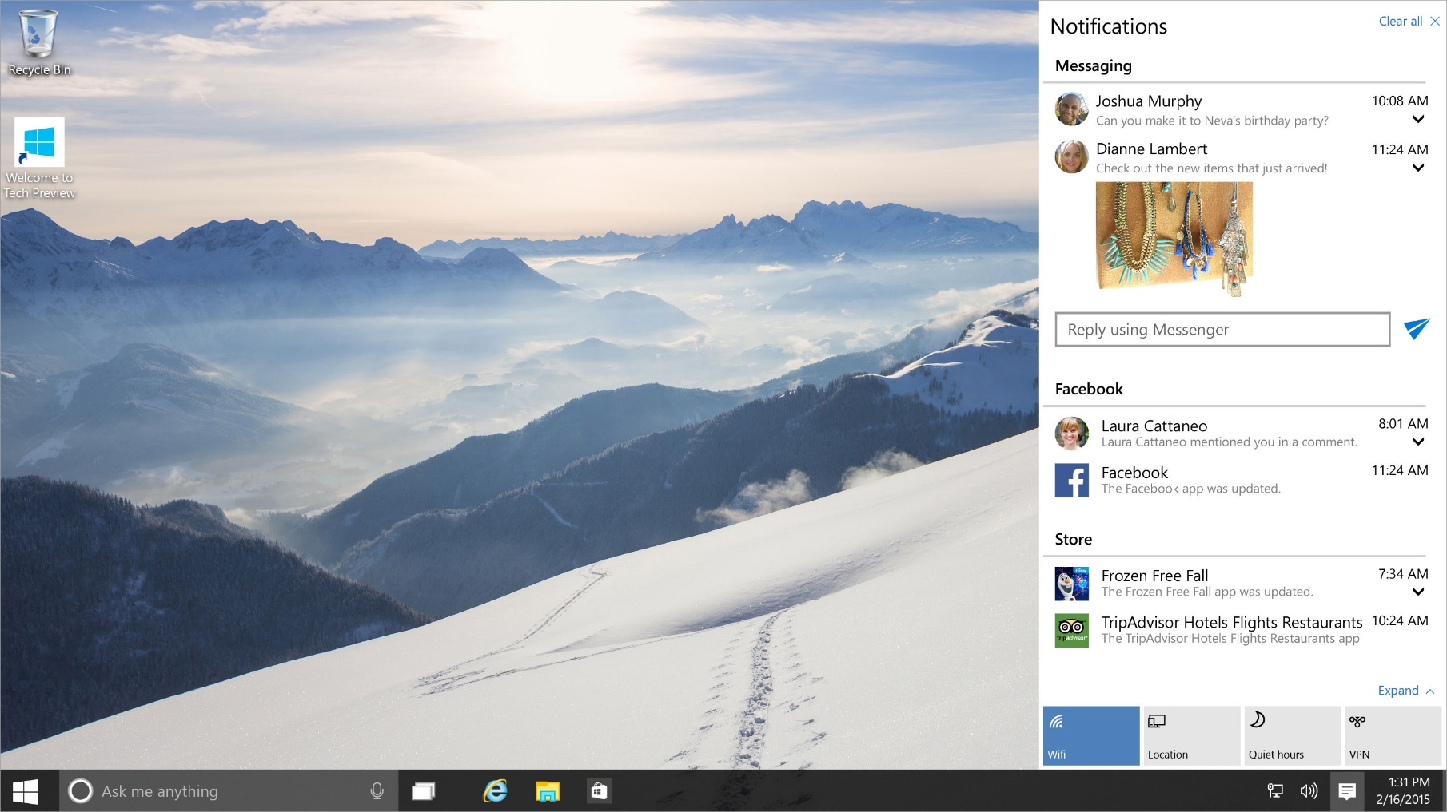
#3. Upgrade to windows 10…
Dismiss or act on a notifications like answering an email. And you also get
one-touch access to your most frequent settings.
Notes:
Dismiss or act on a notification from here—like answering an email—without pausing your movie. And you also get one-touch access to your most frequent settings.

Slide 13
#3. Upgrade to windows 10…
Get a powerful built in digital assistant that you control when it comes to what
she knows and remembers.
Notes:
Cortana is a digital assistant personalized to meet your needs. Type what you need or say “Hey Cortana” to get her attention.

Slide 14

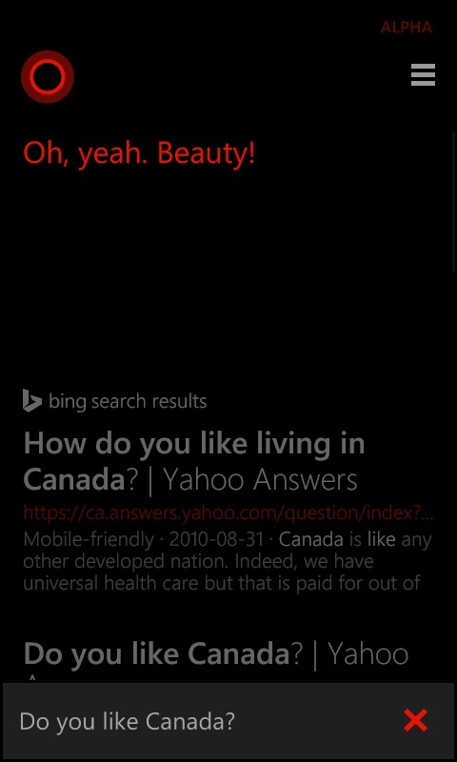

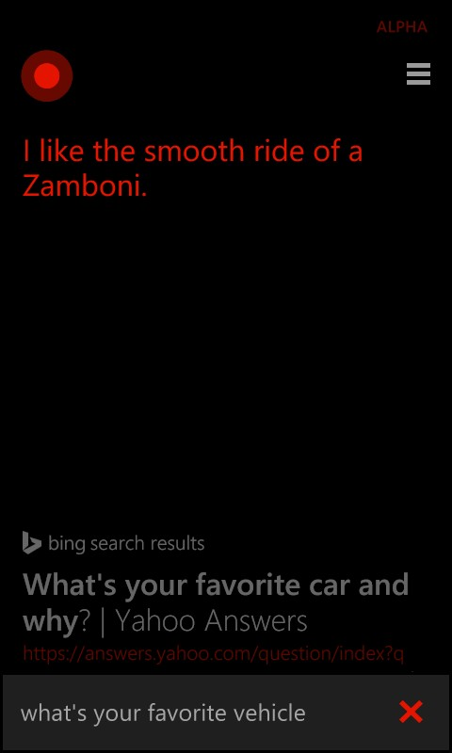
#3. Upgrade to windows 10…
She even understands Canadians.
Notes:
Cortana is a digital assistant personalized to meet your needs. Type what you need or say “Hey Cortana” to get her attention.

Slide 15
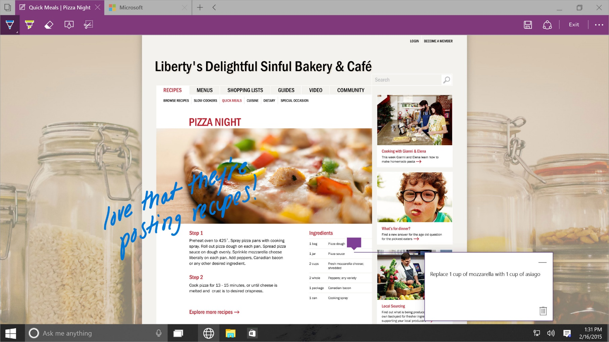
#3. Upgrade to windows 10…
With Microsoft Edge you can even mark up webpages directly using web notes.
Notes:
Now you can do even more on the web with Microsoft Edge. Webpages look and work beautifully with fast and fluid browsing.
Switch to reading mode for a better reading experience where you can focus on your content distraction-free.

Slide 16
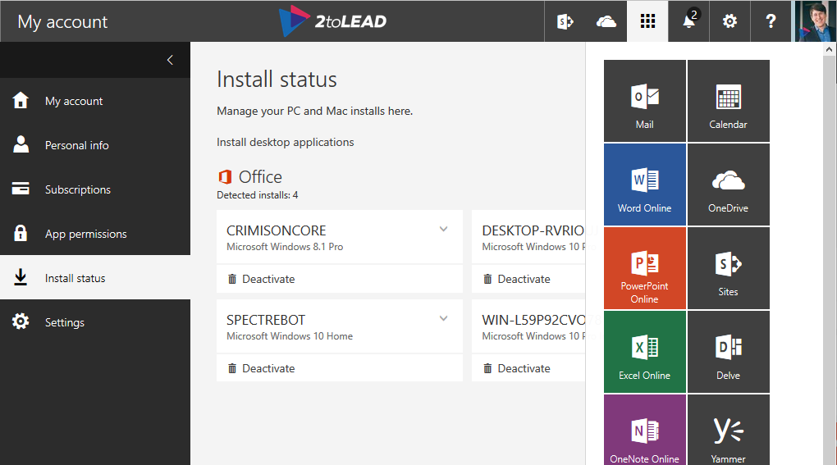
#4. subscribe to office…
Get the full suite of apps that every modern business should have.
Office always stays up to date, with no cost, work or time required for updates.
Notes:
Upgrade to Office 365 for a full suite of apps that every modern business should enjoy, with no upfront costs for software. From the latest version of classic apps like Word and Excel to video conferencing and online meetings, Office 365 empowers staff with enterprise-strength productivity tools. And because Office always stays up to date, there’s no cost, work or time required for updates.

Slide 17
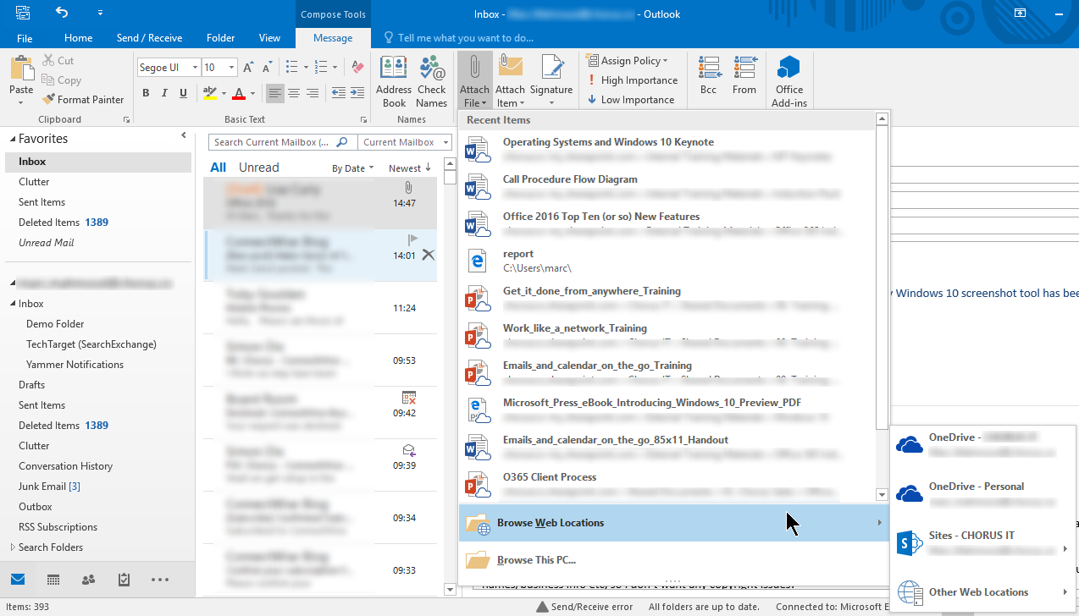
#4. subscribe to office…
Get powerful capabilities like finding the feature you are looking for faster.
Or sharing a modern attachment from Outlook.
Notes:
Upgrade to Office 365 for a full suite of apps that every modern business should enjoy, with no upfront costs for software. From the latest version of classic apps like Word and Excel to video conferencing and online meetings, Office 365 empowers staff with enterprise-strength productivity tools. And because Office always stays up to date, there’s no cost, work or time required for updates.

Slide 18
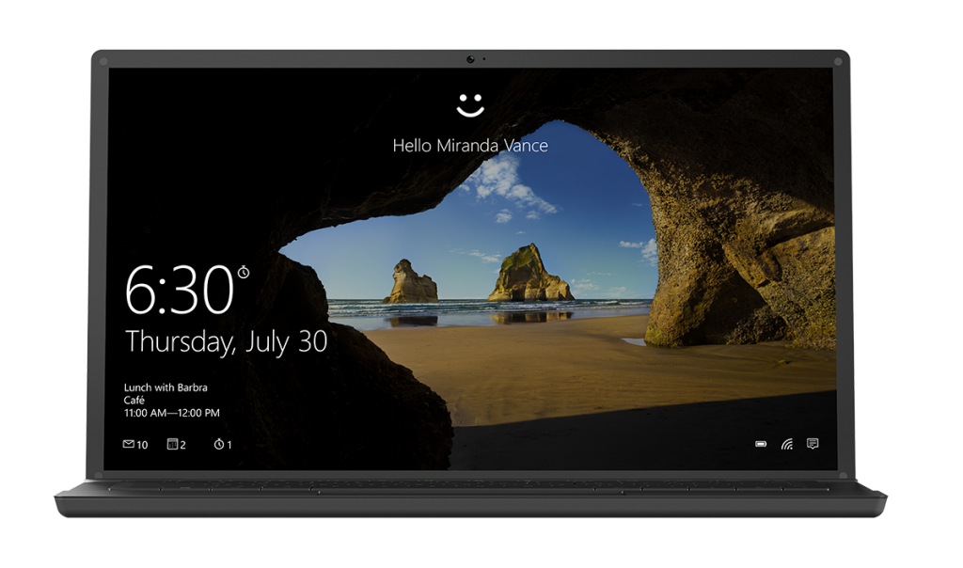
#5. Improve IT Security…
Whether it’s Windows 10, Office 365 or Azure there are lots of ways to improve
security without significant investment.
Notes:
Security concerns, like data leaks, viruses, and systems failures can result in lost productivity, aggravation and reputation damage. Do not wait until you have experienced losses from a cyber-threat to upgrade. Embrace a solution like Microsoft Azure to ensure your data and apps are always available and secure in the cloud, protected by advanced encryption and firewalls.

Slide 19
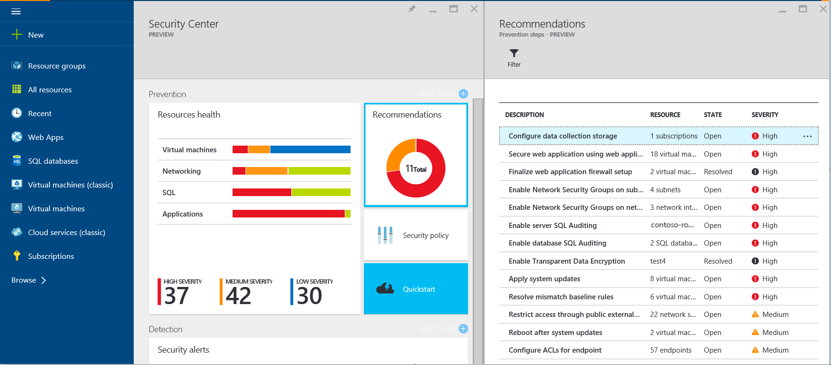
#5. Improve IT Security…
Whether it’s Windows 10, Office 365 or Azure there are lots of ways to improve
security without significant investment.
Notes:
Security concerns, like data leaks, viruses, and systems failures can result in lost productivity, aggravation and reputation damage. Do not wait until you have experienced losses from a cyber-threat to upgrade. Embrace a solution like Microsoft Azure to ensure your data and apps are always available and secure in the cloud, protected by advanced encryption and firewalls.

Slide 20
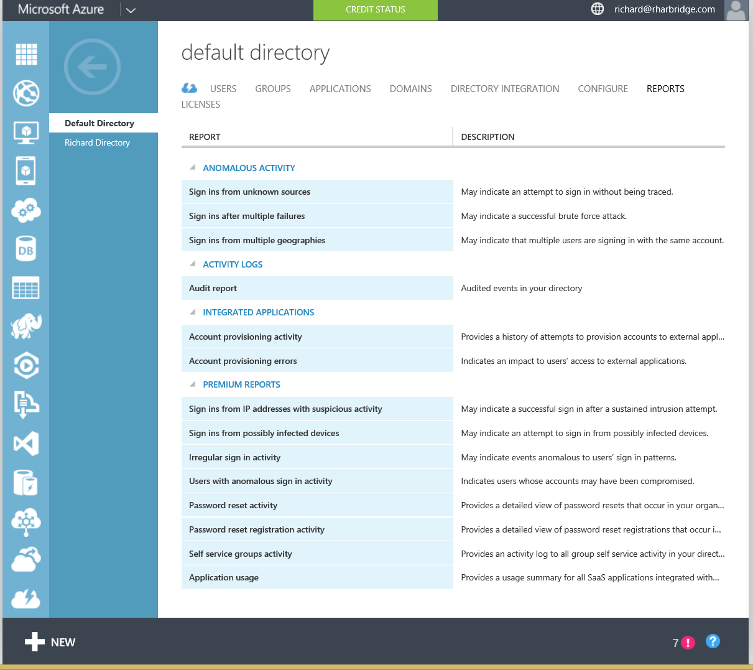
#5. Improve IT Security…
Whether it’s Windows 10, Office 365 or Azure there are lots of ways to improve
security without significant investment.
Notes:
Security concerns, like data leaks, viruses, and systems failures can result in lost productivity, aggravation and reputation damage. Do not wait until you have experienced losses from a cyber-threat to upgrade. Embrace a solution like Microsoft Azure to ensure your data and apps are always available and secure in the cloud, protected by advanced encryption and firewalls.

Slide 21
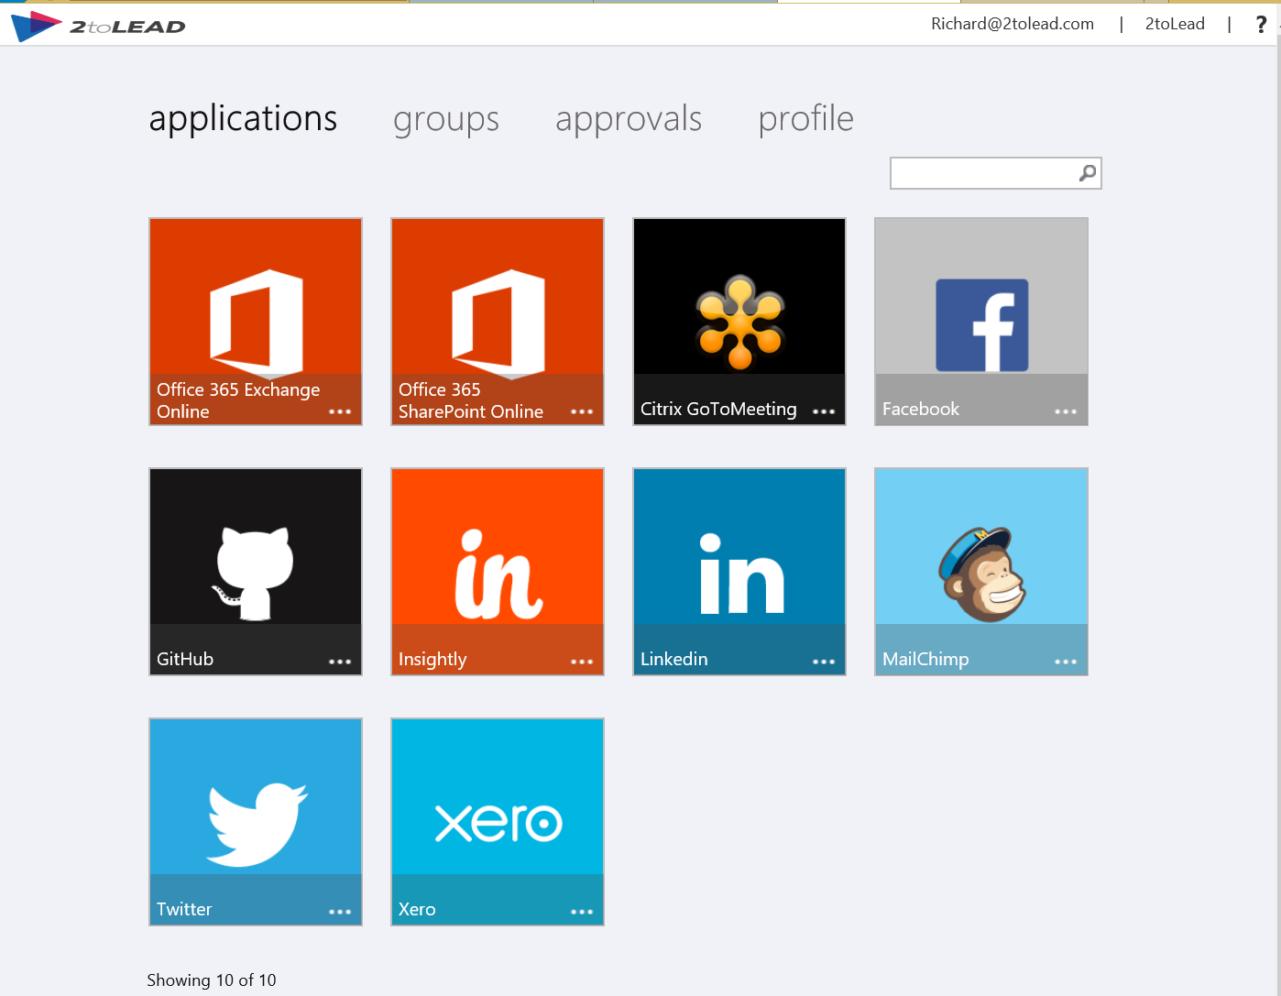
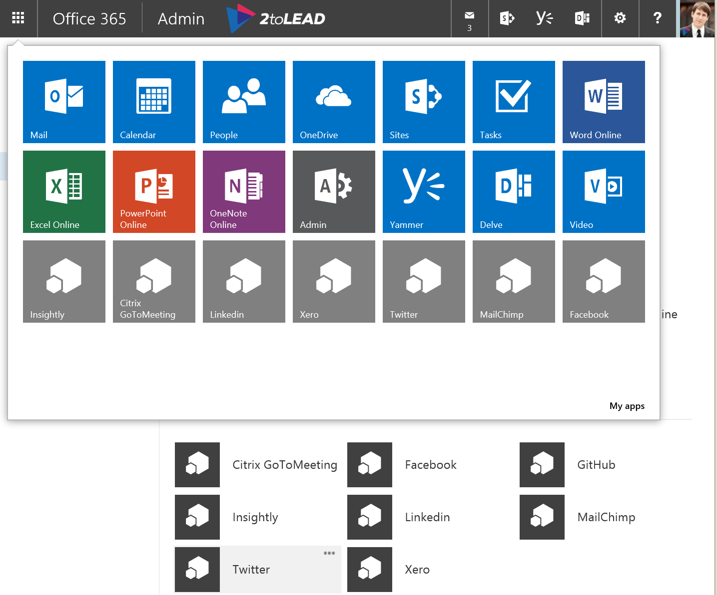
#6. Simplify device management…
Get a single mobile management solution for all devices that saves both time and
money. Enterprise Mobility Suite from Microsoft is 50% less than buying standalone -
giving employees self-service tools and single-sign on to reduce management costs.
Notes:
We say again: a single mobile management solution for all of your devices saves a lot of time and money! At 50% less than the cost of buying standalone solutions, Microsoft Enterprise Mobility manages Windows, Android™ and Apple® devices, introduces self-service employee tools to reduce management costs and provides single-sign on to thousands of apps, like Salesforce.

Slide 22
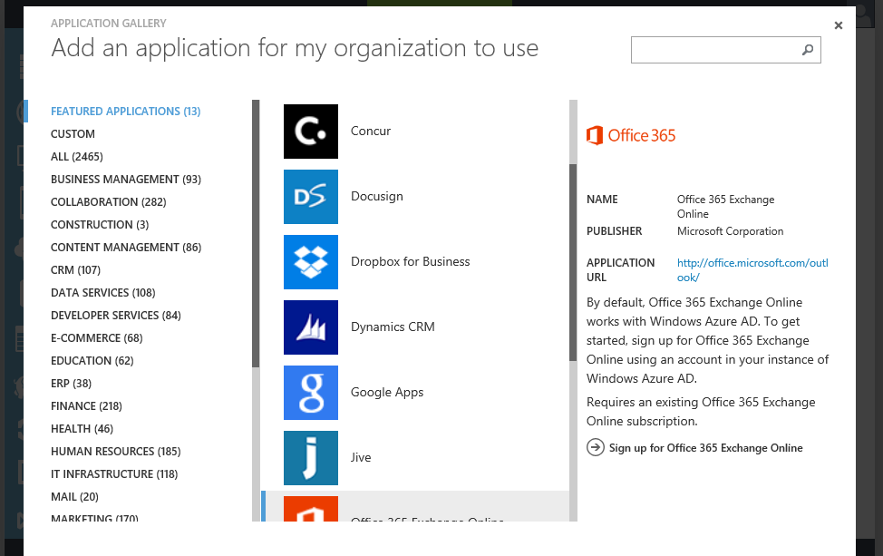
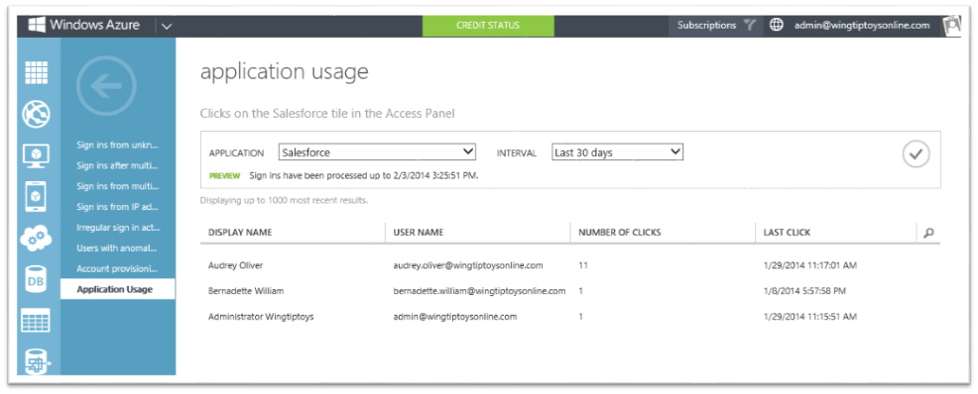
#6. Simplify device management…
Get a single mobile management solution for all devices that saves both time and
money. Enterprise Mobility Suite from Microsoft is 50% less than buying standalone -
giving employees self-service tools and single-sign on to reduce management costs.
Notes:
We say again: a single mobile management solution for all of your devices saves a lot of time and money! At 50% less than the cost of buying standalone solutions, Microsoft Enterprise Mobility manages Windows, Android™ and Apple® devices, introduces self-service employee tools to reduce management costs and provides single-sign on to thousands of apps, like Salesforce.

Slide 23
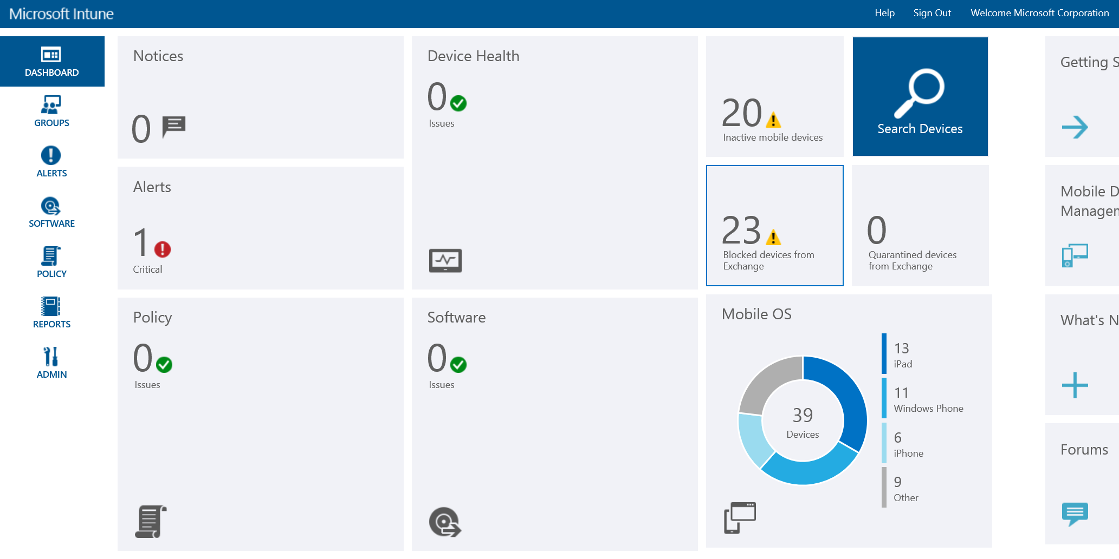
#6. Simplify device management…
Get a single mobile management solution for all devices that saves both time and
money. Enterprise Mobility Suite from Microsoft is 50% less than buying standalone -
giving employees self-service tools and single-sign on to reduce management costs.
Notes:
We say again: a single mobile management solution for all of your devices saves a lot of time and money! At 50% less than the cost of buying standalone solutions, Microsoft Enterprise Mobility manages Windows, Android™ and Apple® devices, introduces self-service employee tools to reduce management costs and provides single-sign on to thousands of apps, like Salesforce.

Slide 24
Get A New Technology Plan…
Struggling on where to start? Work with us to cut costs and boost productivity.
We can help you plan how to transform and improve your business.
Notes:
If the idea of modernizing your business intrigues you, but you’re not sure where to start, your best bet is to work with a Microsoft Certified Partner to develop a plan unique to your needs and wants. If you already have a partner, simply ask them to put forward a proposal to cut costs and boost productivity. If you don’t have a partner already, we can help you find one today.

Slide 25
Thank You!
Organizers, Sponsors and You for making this possible.
EMUG.ca
WorkingSysAdmin.com
ThomasRayner.ca
Message Me On LinkedIn or Twitter
Twitter: @MrThomasRayner LinkedIn: linkedin.com/in/ThomasRayner

